Slide 1
SaaS Web App
Live on DigitalOcean Kubernetes (DOKS)
Deployment walkthrough • cluster: k8s-sass-web-app • region: sfo2

Slide 2
ENGAGEMENT GOALS
What this deployment needed to prove
1
2
3
4
Scalability
Performance
Reliability
Cost
Add pods automatically as load grows — no manual intervention.
Fast responses even while scaling in real time.
Zero-downtime deploys, health-checked routing.
Right-sized infrastructure, real billing data, no waste.
SaaS Web App on DOKS | Live Deployment Walkthrough
2

Slide 3
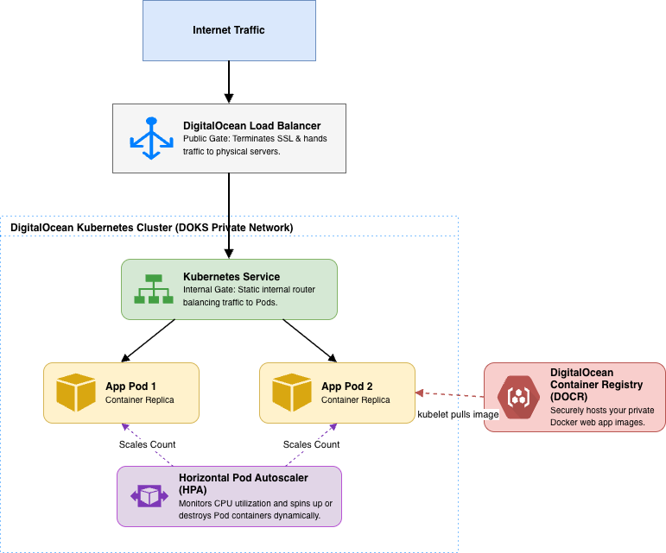
SOLUTION ARCHITECTURE
Traffic flow: users to autoscaled pods
SaaS Web App on DOKS | Live Deployment Walkthrough
3

Slide 4
IMPLEMENTATION
Containerization and Kubernetes configuration
Flask app
Service (LoadBalancer)
3 routes: / (homepage), /healthz (probes), /load (CPU burn — triggers autoscaling for testing).
Provisions a real DO Load Balancer, health-checked on /healthz, port 80 → 5000.
Deployment
HorizontalPodAutoscaler
2 replicas, RollingUpdate with maxUnavailable: 0 — zero dropped requests during deploys.
autoscaling/v2, CPU 60% target, scales 2→6 replicas.
Resource requests/limits
metrics-server
250m/500m CPU, 128Mi/256Mi memory per pod — the basis for both scheduling and HPA math.
NOT preinstalled on DOKS — installed manually with a DOKS-specific TLS patch (more on this next).
SaaS Web App on DOKS | Live Deployment Walkthrough
4

Slide 5
COST OPTIMIZATION — REAL BILLING DATA
Actual monthly cost: $36.00 baseline
Component
Spec
Monthly
Container Registry
saasappregistry, 55.25 MiB (Starter, free ≤ 500 MiB)
$0.00
DOKS control plane
1 managed cluster
$0.00
Regional Load Balancer
1 node, flat rate
$15.00
Worker nodes
2 × s-1vcpu-2gb @ $12/node
$24.00
Total baseline
$36.00 / month
If node-pool autoscaling is enabled (2→4 nodes), peak sustained cost rises to ~$63.00/month — a ceiling, not the expected steady-state. Inbound traffic is always free; outbound has a bundled pooled allowance with flat $0.01/GB overage.
SaaS Web App on DOKS | Live Deployment Walkthrough
6

Slide 6
QBR SUMMARY
Recommendations for scaling & cost
1
Enable node-pool autoscaling
Pool is fixed at 2 nodes today — HPA could ask for more pods than can be scheduled.
2
Add memory as a second HPA signal
CPU alone can miss a memory-bound bottleneck.
3
Stand up a staging namespace
All testing currently happens against the same cluster.
4
DO Spaces CDN — only if a static frontend is added later
SaaS Web App on DOKS | Live Deployment Walkthrough
7

Slide 7
QBR SUMMARY
Risks to monitor & mitigations
Risk
Impact
Mitigation
In-memory app state
Data loss on pod restart
Migrate to DO Managed Postgres before GA
Fixed 2-node pool
HPA can request more pods than schedulable
Enable node-pool autoscaling
metrics-server is a manual install
New cluster don’t have it
Documented as day-0 runbook step
No automated alerting yet
Team may miss a degraded state
Wire up DO Monitoring alerts
Single-region deployment
Regional outage takes the app down
Evaluate multi-region once SLAs are defined and enable high availability control plane
SaaS Web App on DOKS | Live Deployment Walkthrough
8

Slide 8
Next steps
Run formal load/latency testing and fold real numbers into the QBR
Enable node-pool autoscaling and wire up DO Monitoring alerts
Scope migration to DO Managed Postgres for persistent state
Questions?

